Slide 1
Grassland Birds in the Foothills Parkland
Zachary M. Moore
University of Manitoba
NCC Conservation Science Fellow
zacharymilosmoore@gmail.com
KOPER LAB @ The University of Manitoba

Slide 2
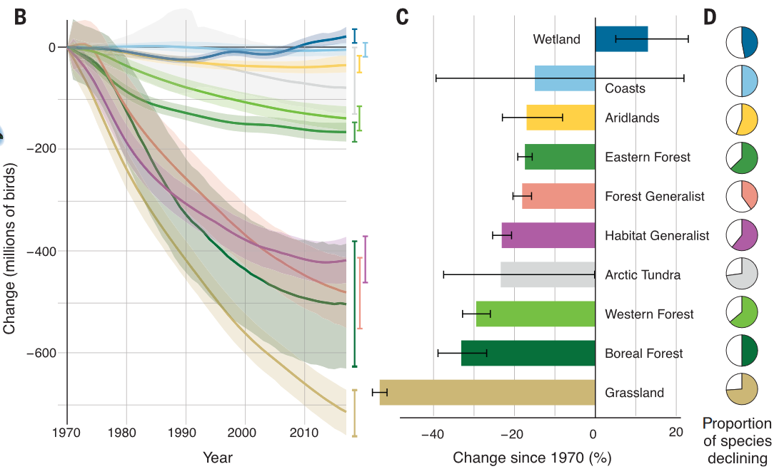
Birds Are Declining, Especially in Grasslands
“Population loss is not restricted to rare and threatened species, but includes many widespread and common species that may be disproportionately influential components of food webs and ecosystem function.”
Rosenberg et al., 2019
Notes:
So, I don’t think it’ll come as a shock to anyone that birds are declining, but birds that live in grasslands have declined more in the past 50 years than birds that live in any other habitat type across North America, and this decline isn’t just restricted to the endangered species, but is also prevalent across common and widespread species. Primarily these declines are due to habitat loss, but

Slide 3
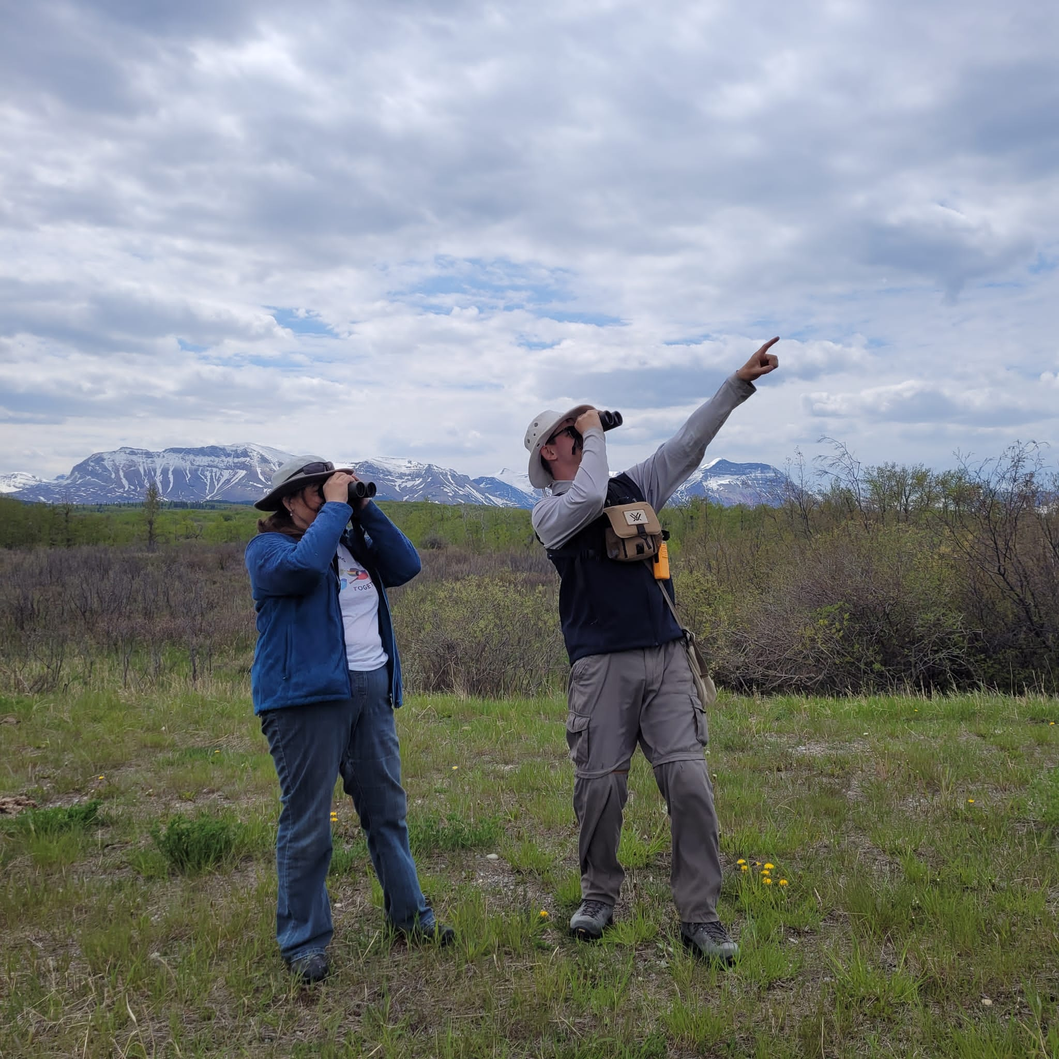





What Influences Bird Communities?
Vegetation Community
Topography
Avian Habitat
Disturbance
Landscape Structure
Notes:
Birds in the grasslands that we have left are affected by many different habitat variables ranging from very local, such as patches of bare ground created by intensive cattle grazing, to the topography of the entire region

Slide 4
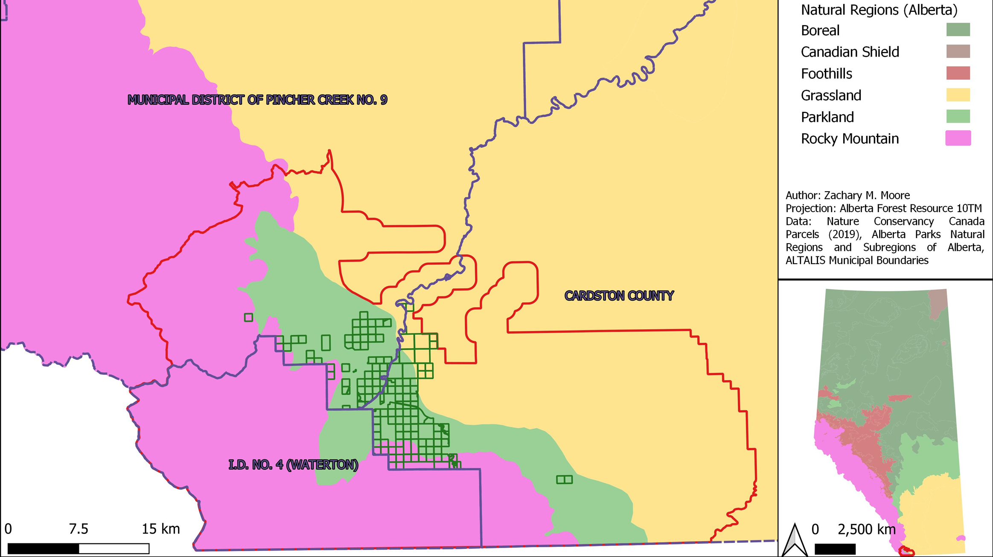
Study Region: Waterton Foothills Parkland
Large concentration of private conservation projects in Foothills Parkland Natural Subregion
Transition between Grassland and Rocky Mountains
Managed for cattle production and biodiversity conservation buffering Waterton Lakes National Park
Treaty 7 Territory: Home of the Blackfoot Confederacy, the Stony Nakoda, and the Tsuut’inna First Nations
Notes:
In the area that I’m working, topography is a hugely important part of the way that grasslands are spread across a landscape. Parkland habitats are widespread through Canada, and they are typically made up of aspen stands interspersed between grassland patches. Parklands are usually a transition between grassland and boreal forest driven by moving south to north, but in the Waterton Area, right at the corner of Alberta, BC, and Montana to the south, this type of habitat is driven by elevation moving into the mountains instead of by latitude, which creates a lot of topography-driven differences between this region and other parkland regions

Slide 5
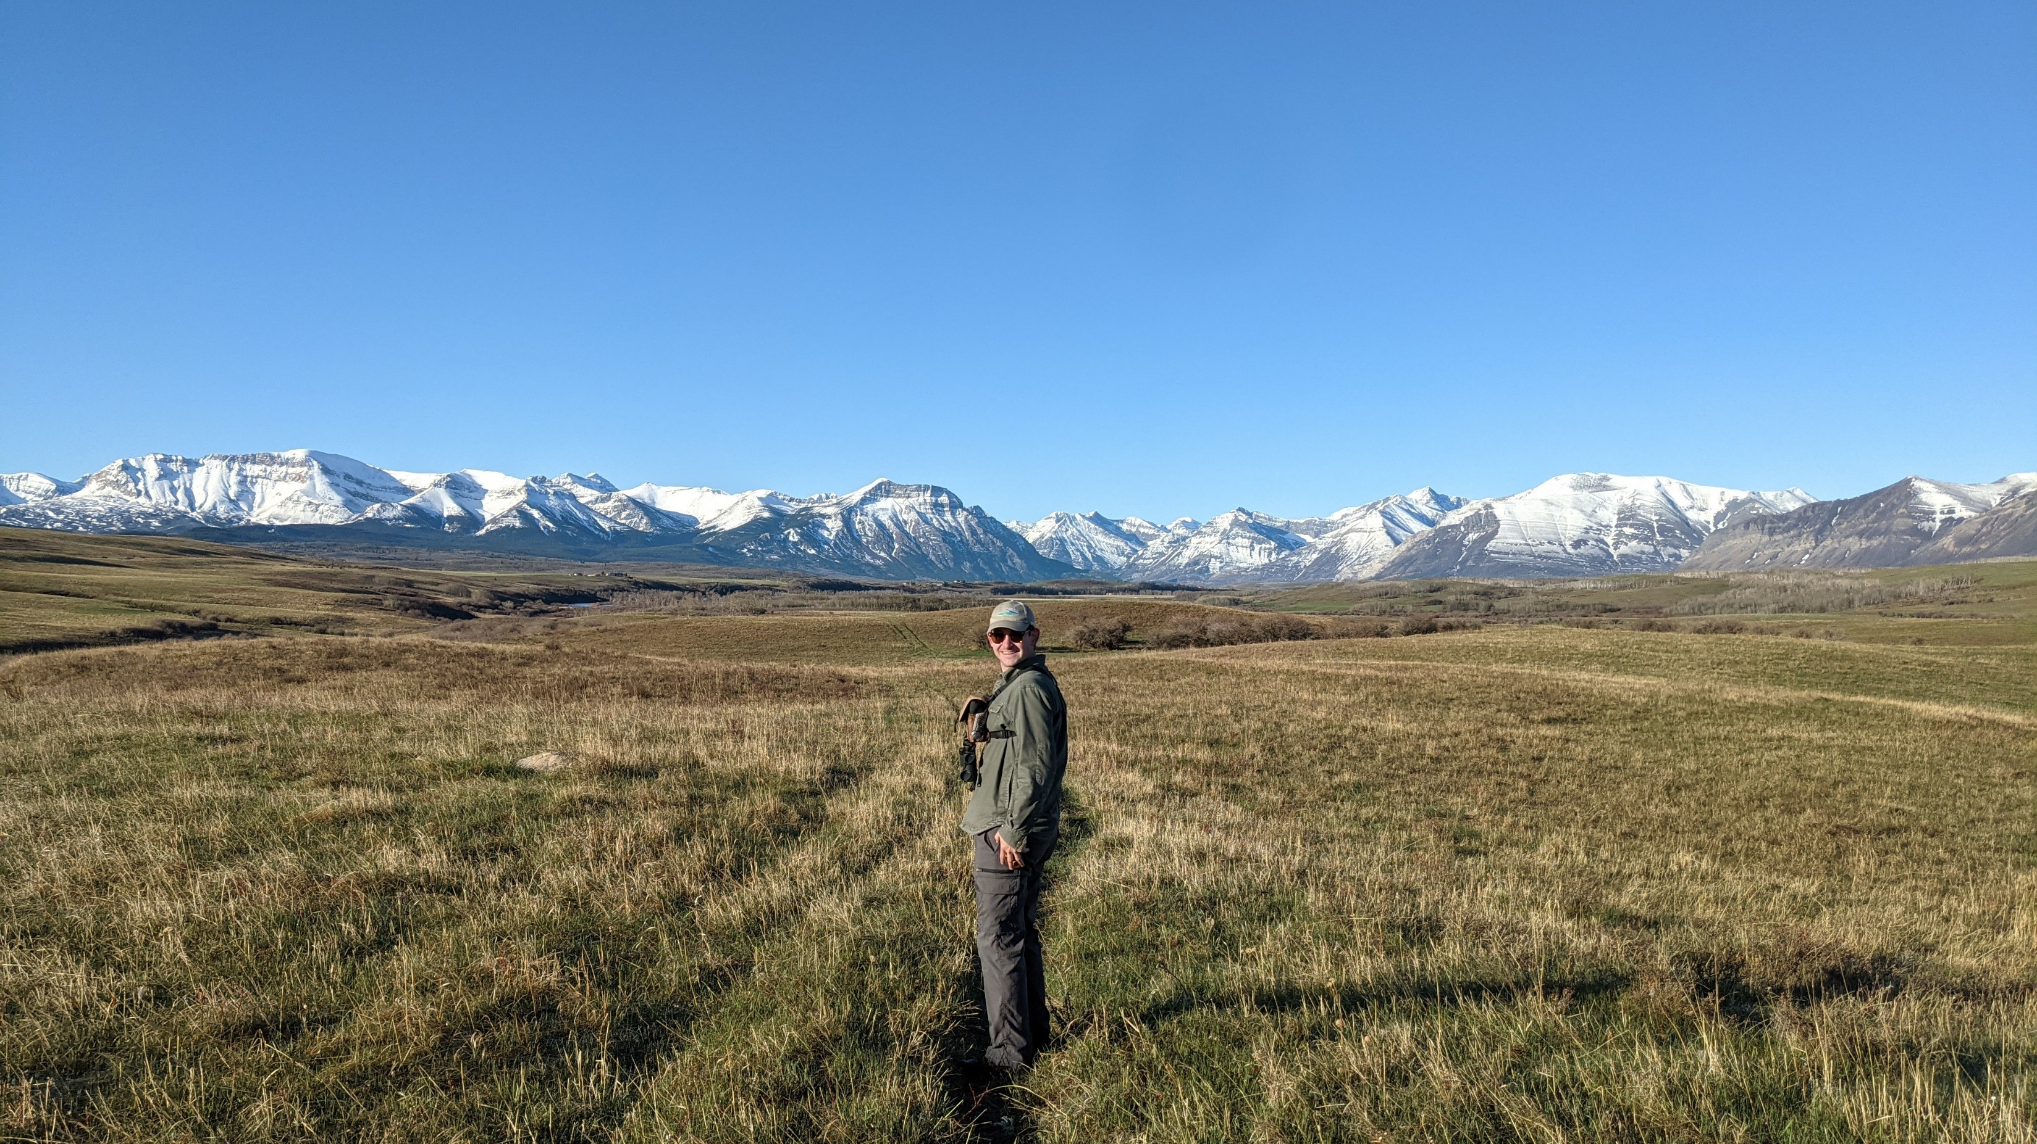
Why study grassland birds here?
Conservation
Research
Management
Data Gap
Notes:
A key thing about birds is that they respond to habitats differently in different regions, and so in the cycle of adaptive management in conservation, it’s important to understand what is happening here specifically to declining bird populations. My study area is a large concentration of private conservation projects run by the Nature Conservancy of Canada, and exists in an area where there has been little study of the bird communities by public, non-profit, or academic sources, to the point that there was little understanding of which species were using the patches of grassland habitat available.

Slide 6
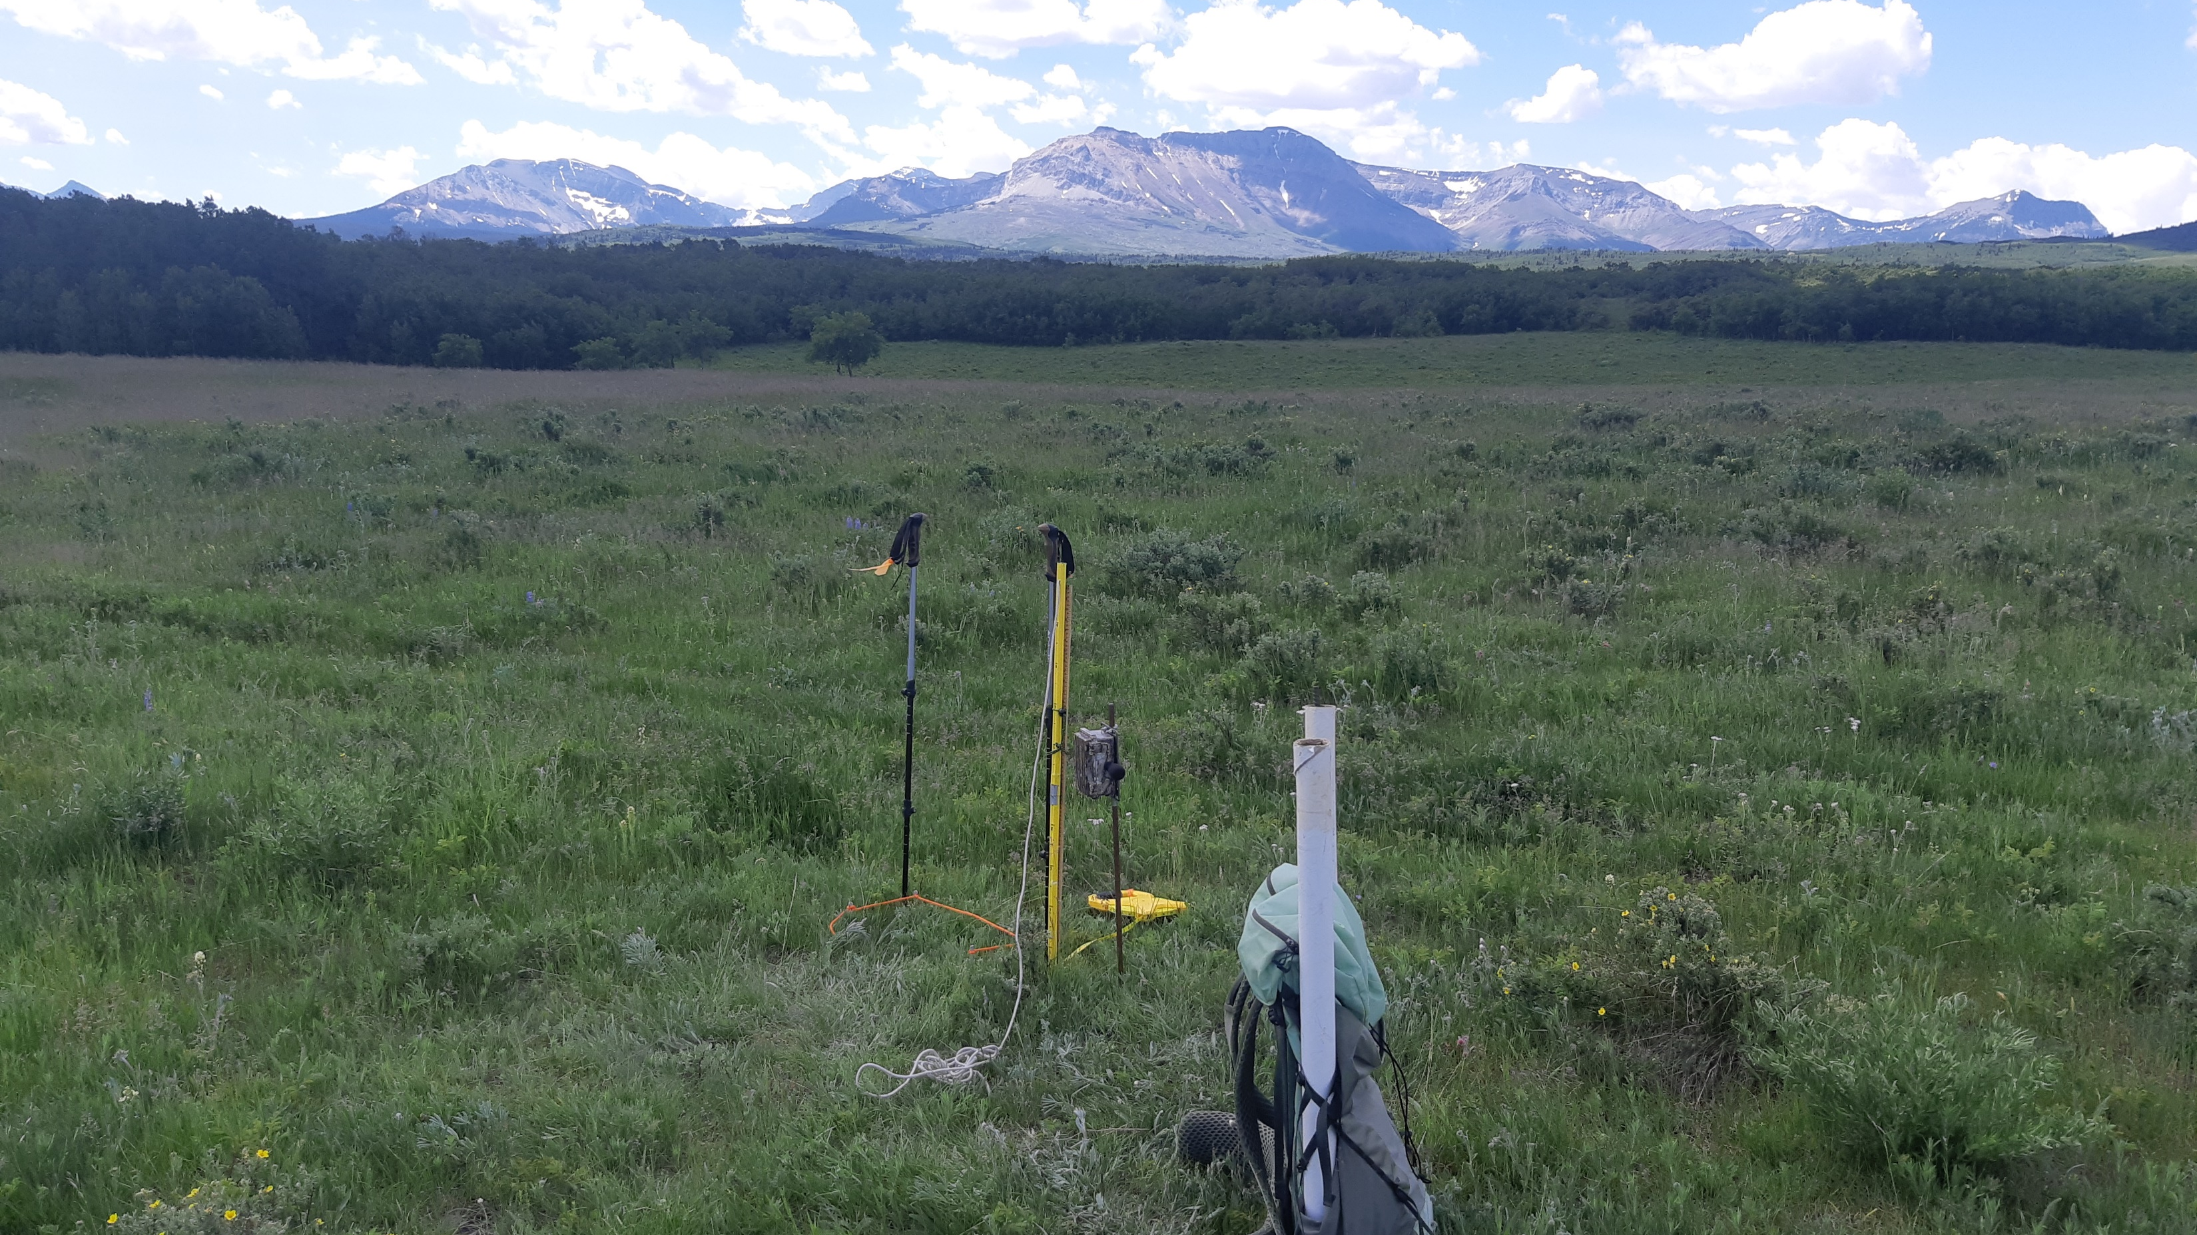
How to study grassland birds here?
ARU Point Counts in 2021, 2022 at 192 Sites
Statistical Modelling
Vegetation Surveys/ Range Health
Spatial Landscape Analyses
Notes:
So to study these communities, I used autonomous recording units, or ARUs, which record sound for a set period of time at dawn and dusk when birds are loudest, to determine which birds were at nearly 200 grassland sites, and then I measured a bunch of aspects of the local grassland vegetation and the way that grasslands were laid out around these sites at the landscape scale. With all these data, I ran models to determine which factors were influencing individual species and the diversity of groups of species.

Slide 7
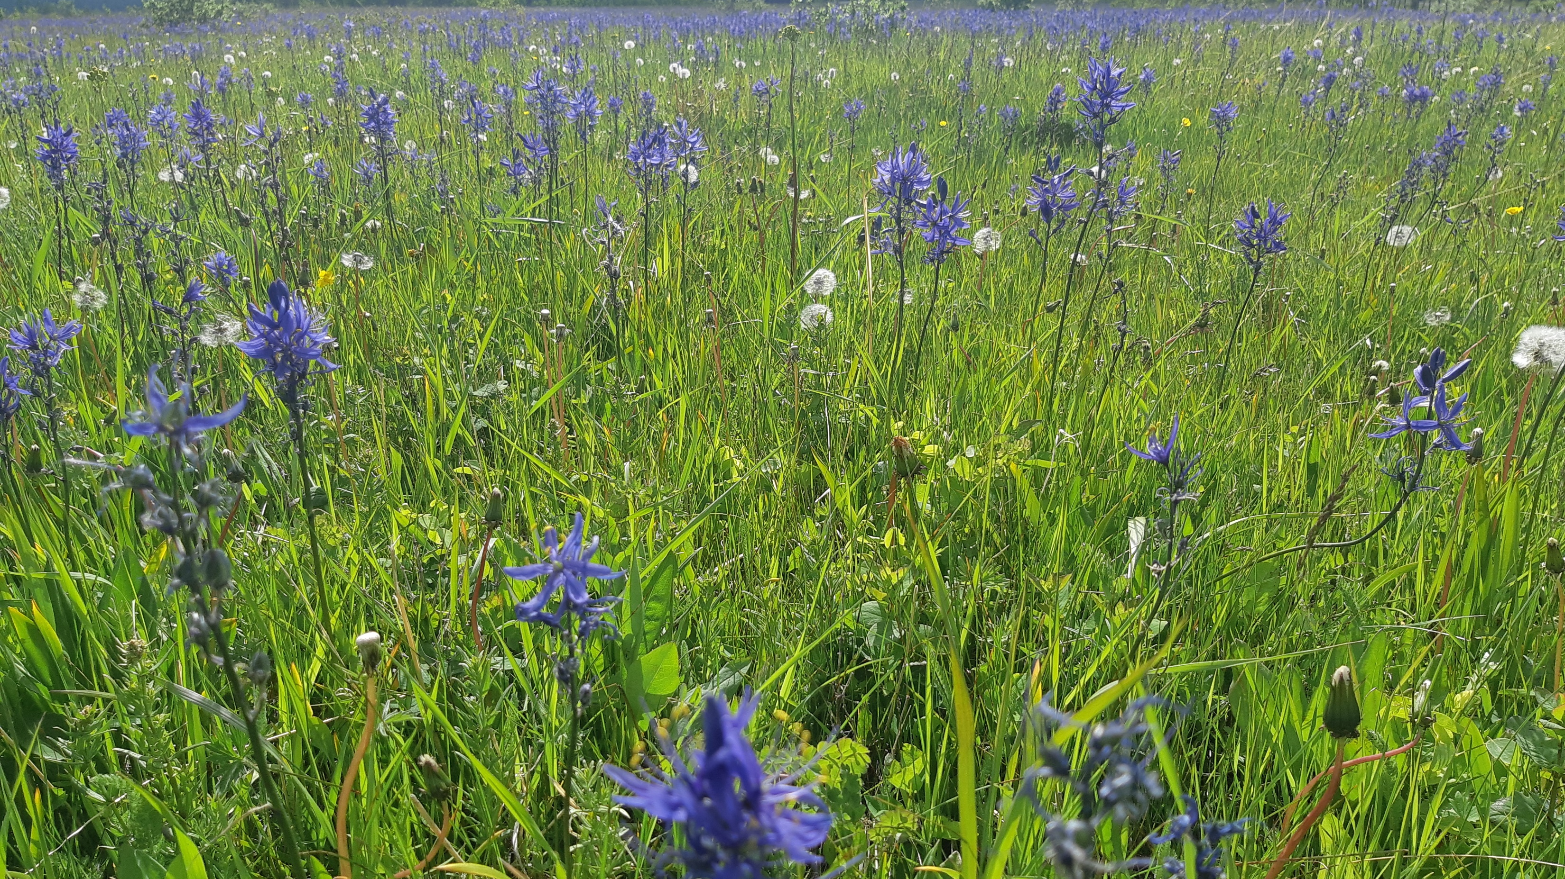
What influences grassland birds here?
Obligate Diversity
Increased with…
Facultative Diversity
Increased with…
Less Non-native vegetation
Shorter Grass
More Shrubs
Proximity to Prairie Ecozone
Less Non-native vegetation
Less topographic variation
More grassland fragmentation when topography varies
Proximity to forests
Notes:
So in grasslands, you can separate the birds that use them into two groups: obligate birds that use grasslands for all of their life cycle, and facultative birds that only use the grasslands for part, such as foraging.
My results show that in this region, you get more diverse obligate bird communities in grasslands with shorter grass, more shrubs, and less non-native cover locally, but any effects of the layout of grasslands at the landscape scale are overwritten by the location of sites relative to the prairie ecozone of Canada. This makes sense given the fact that this parkland region is right at the western edge of many bird’s ranges, and so you get less obligate grassland birds as you move further into the parkland region.
In contrast, for facultative birds, there’s also lower diversity associated with non-native vegetation, but their diversity increases with proximity to forests, a local edge effect, and has complicated landscape effects, where topographic complexity, which you can think of as hilliness, generally decreases diversity of facultative birds, unless the grasslands are fragmented when the area is very hilly. This is probably related to the diversity of habitats available, such as willows and shrubs in sheltered areas between hills that would fragment the grasslands.

Slide 8
What’s Left?
Solidify Results for Entire Grassland Bird Community
Management Recommendations
Linking to Landscape Ecology Theory
Writing!
Notes:
These are my preliminary results to this point, and so my next steps are to solidify my interpretations of the results for the entire grassland community, create management recommendations for NCC, and flush out the linkages to landscape ecology theory, which I only brushed over in this talk.

Slide 9
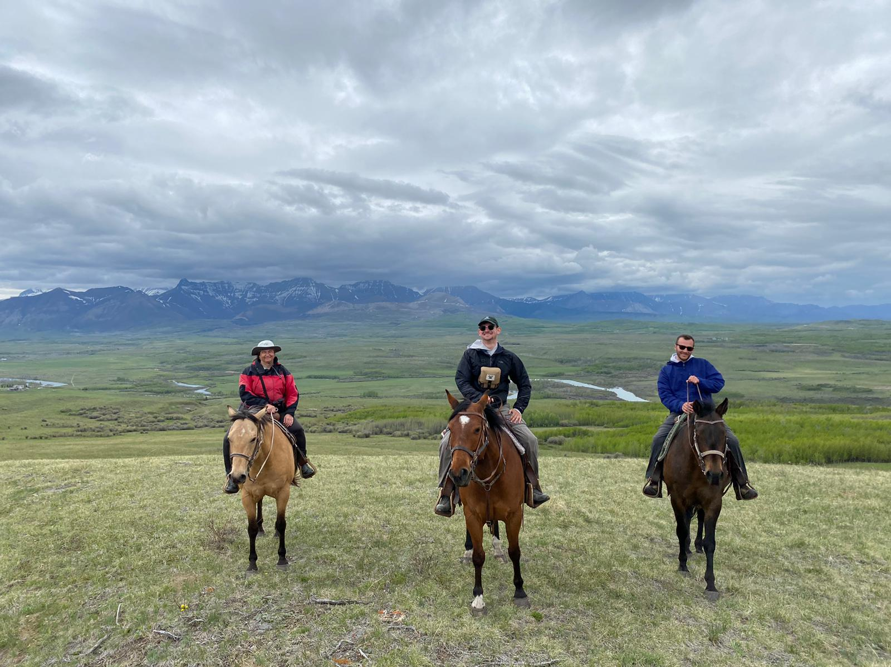


Thanks!
zacharymilosmoore@gmail.com
https://zacharymilosmoore.ca/visuals/gsb_proposal_v3.pdf
Notes:
Thanks for listening

Slide 10
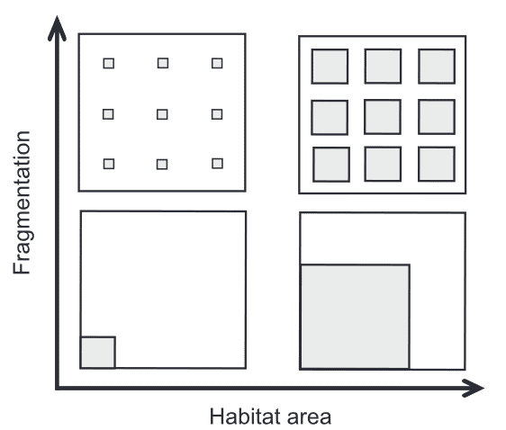
How does habitat fragmentation affect grassland bird communities?
Well Accepted:
Less habitat = less abundance.
Edge effects can be bad for birds, especially in grasslands
Birds respond to landscape configuration at large (1-100 km) scales
Less Well Understood:
What are the effects of patchy versus contiguous grassland on bird diversity when the amount is held constant here?
How does fragmentation interact with a mountainous landscape here?
Tscharntke et al. 2012
Notes:
Include something about why small habitat patches are important and cite Fahrig work

